Slide 1
DHL Supply Chain Transport Order Portal (TOP)
PUBLIC
Harley Davidson Supplier Portal Training
Powered by MySupplyChain™
TOP User Guide
DHL Supply Chain – Excellence. Simply Delivered.
Automotive

Slide 2
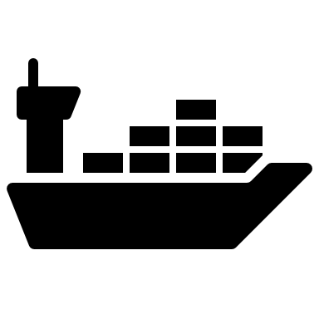
Project Apollo and TOP
TOP = Transport Order Portal and is part of the OTM. TOP is where suppliers will create ready to ship notifications.
Apollo is the project to implement the Oracle Transportation Management System (OTM), which will integrate with H-D’s SAP system, tier 1 suppliers, 3PLs and freight carriers.
OTM is supported by two controls towers in Livonia, Michigan and Bangkok that are staffed by DHL and provide 24/7 support to H-D for international shipments, freight tendering, spot quoting, shipment status updates, issue resolution, and carrier management.
Real time data insights and product visibility! The ability to monitor and manage our transportation network and drive down costs, reduce inventory and optimize capacity.

Slide 3
Apollo Project Timeline
Sept. 11
Jan. 11
April 2024
P&A and A&L
Non-North American supplier to KemKrest and GDC
Motorcycle Manufacturing
Non-North American suppliers to Tomahawk power train operations and York
Motorcycle Manufacturing
Thailand supplier to Thailand manufacturing
Int’l supplier to Thailand manufacturing
North American supplier to Tipp City

Slide 4
Supplier Requirements
• Suppliers are to send/add ASN’s.
Supplier responsible for accurate ASN data attributes.
• Responsible for performing export clearance.
• The suppliers are responsible for developing, preparing, and paying for the necessary packaging.
• Suppliers to submit RTS notification via TOP portal.

Slide 5
The Transport order portal (TOP)- Step by Step PORTAL NAVIGATION

Slide 6
When to use TOP
TOP will only be utilized for releasing PO's where H-D is responsible for the freight cost
UPS (small parcel) shipments will be released in TOP. If the TMS determines that small parcel is the appropriate mode, the routing instructions back from DHL will indicate that it should ship parcel. At that point, the shipment will be closed in DHL's system and it is up to the supplier to execute the parcel shipment using their current parcel carrier. We will not have integration to track and trace with parcel movements
The TMS will not assign transportation for the movement of goods from your location to the port (depending on incoterm)
When supplier is paying for air freight, they can either:
Release the order in TOP, and H-D can pay for it and debit the supplier back with prior approval or
Supplier can tender shipment to their own carrier outside of DHL

Slide 7
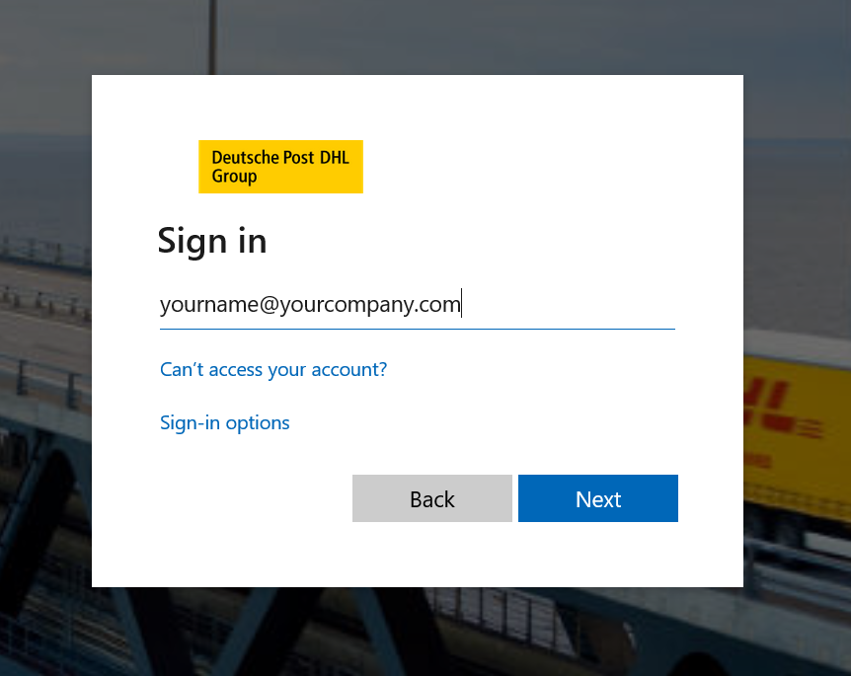
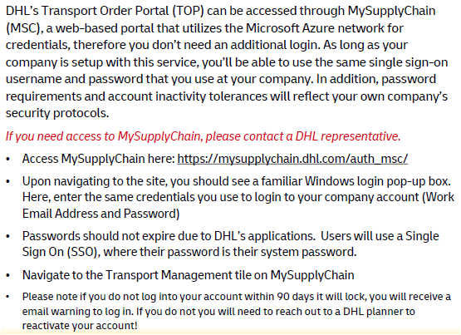
Access to TOP
Internet Browser Requirements :
•Google Chrome “Preferred Browser”
•Microsoft Edge
Alternate access link direct to portal - https://dsctop.dhl.com/

Slide 8
Flow of Events in TOP
Supplier will login to TOP and submit their ready to ship (RTS)
DHL will tender the shipment to the carrier using the proper mode
Carrier accepts the tender
Supplier will receive communication of who the carrier is and when the material will be picked up
After physical dispatch of those goods, supplier is to submit their ASN. The ASN information is interfaced to DHL's system via EDI. The ASN process will not change

Slide 9
Order Review - Search
1) Navigate to the Purchase Orders tab of the application
2) Enter your order number or PO number here
3) Click the box and then the red release button on the corner
4) Supplier can search without knowing their PO # by clicking the filter and entering their vendor ID or destination (refer to next page for instructions)

Slide 10
Getting Started and Navigation –
TOP Portal Navigation Icons
Purchase Orders
(unplanned)
Search, Edit, Modify, Cancel, Release
The “Purchase Orders” screen will be the initial screen suppliers see once logging in.
Orders
(planned / released)
Search, Edit, Modify, Cancel
Profile
View and Confirm current login credentials
Logout
Exit the Applications

Slide 11
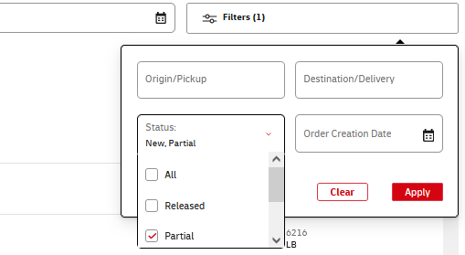
Order Review - Search
Supplier can search without knowing their PO by clicking the filter and entering either their pickup location, delivery location, Order Status or Order Creation date.

Slide 12
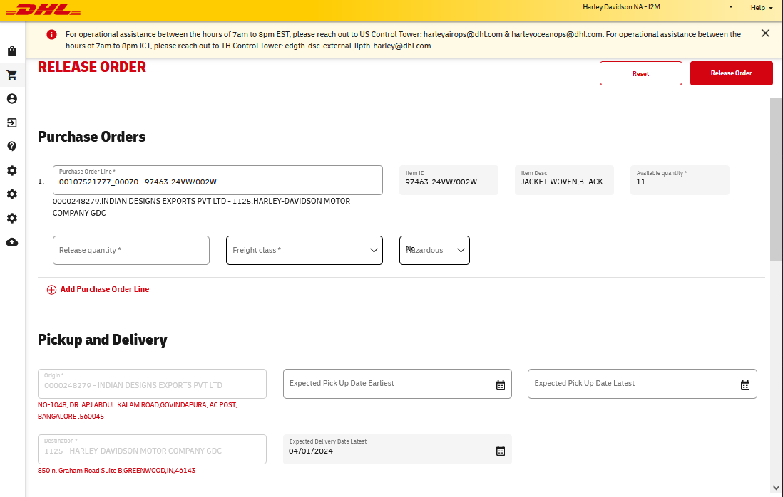
Release Order – Pickup and Delivery
Once the orders have been selected, you will see the following screens.
The Supplier is responsible to complete all fields within the Pick up, Ship Units, General Information and Remarks sections of the release order.
2) Quantity to Release
This section allows the user to select the qty to release between 1 or all of the available quantity on hand
1) Purchase orders
Indicates the orders you selected
3) Pick up and Delivery
Enter in Expected Pick up date, when freight is ready
4) Hazardous This section allows the user to select whether the order is hazardous or not

Slide 13
Order Modification- Ship Units
Supplier must complete the fields with their unit count, Length, Width, Height and total Weight
All items are listed in INCHES and LBS, a conversion must be done.
Suppliers have the ability to add additional unit lines for different sizes
Weight entered per PO is weight per handling or shipment unit- NOT the total weight of the shipment.
Dimensions entered must be in INCHES (IN) and weight entered must be in POUNDS (LBS).
When building an order, select how many pallets you are going to send for that one order you are releasing
In the order release screen, suppliers are able to confirm order information and verify if items are “stackable”
THIS INFORMATION IS PER PALLET (ONE PALLET)
This feature allows you to enter another line within the PO release. If you have pallets with different dimensions to add, select this feature
Weight per handling/shipment unit, not total weight

Slide 14
Order Modification- General Information / References and Remarks
Supplier to complete Freight Class (Enter “55” for Ocean shipments)
Select Yes / No on Temp Control and Hazardous Freight
1). Select yes or no from temp control drop down
3). Input correct Incoterm Location
2). If Incoterm is not populated please select the correct incoterm for the shipment

Slide 15
References and Remarks- Special Instructions:
Please include the following in the references and remarks if available:
Special instructions should be used for information such as particular gate entry, which dock is available for loading, any loading hour restrictions etc.

Slide 16
Release
Once all the required information is added click “Release”
The order will be released, and the user will be directed to the Order Listing page with the transmission to OTM

Slide 17
Order Listing Status Symbols
Status:
Green: Order is confirmed on a shipment
Yellow: Order has been released and is being planned
Grey: New order awaiting release
Orders
Find your planned released orders

Slide 18
Purchase Orders- Sorting of Lists
Users are able to change the default sorting on Purchase Orders and Order List screens
Purchase Orders - sort by Delivery Date ascending (oldest first)
Order Listing - sort by Pickup Date descending (newest first)
Nice to have – user can change sorting by clicking on column headers
Clicking on a column header sorts the list by that column ascending
Clicking again on the same column header toggles the type sorting - ascending vs. descending

Slide 19
Order Review - Detail
Created Status: Orders have been inputted into the TOP Portal. These orders can still be updated.
Planned Status: Orders have been planned in OTM. Orders cannot be updated.
Confirmed Status: Orders have been shipped.
Shipment Detail: Once shipment is planned, the Shipment ID and Carrier will populate here.
Once orders are planned and confirmed by carriers through DHL Transportation Management Systems, the Carrier SCAC and Shipment ID # (SID#) will populate under the shipment
Order Detail

Slide 20
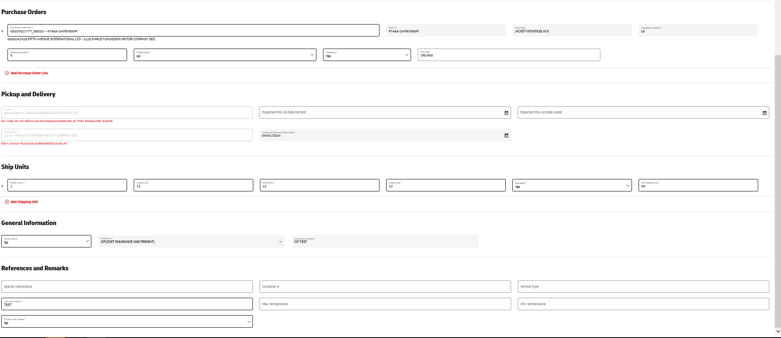
Order Review - Detail
3) To finalize changes, click “Save”. You’ll be redirected to the Order Summary screen and receive a confirmation at the bottom of the screen:
1) Orders can only be edited when in Created status and no Shipment or Carrier Assignment
2) Order Detail Modification
The following can be edited:
Purchase Order
Expected Pick up Date
Pallet Count
Length
Width
Height
Stackable
Weight
TempControl
Hazardous
Special Instructions
Container #
Max Temp
Min Temp
Protect From Freeze

Slide 21
Troubleshooting and tips

Slide 22
Troubleshooting and Tips- TOP Portal
General Tips and Knowledge
If you receive the error message “We couldn't find the order you're looking for, please try again" please reach out to Harleyops@dhl.com
If the PO will not release, please double check that all required information is filled out.
Be sure that the release quantity is lower than the available quantity (or within 5% tolerance of quantity)
If additional user accounts are needed please email cssharleyops@dhl.com
Orders that are planned to shipments will be uneditable
Who to Contact and When
DHL Control Tower:
Question regarding the carrier/shipment
Technical question about TOP
Harley SCA:
Process Questions
Order Questions
Finding Support Materials on H-DSN

Slide 23
DHL Email Contact
US Control Tower - (0700-2000 EST)
Harleyops@dhl.com (Ground)
Harleyoceanops@dhl.com (Ocean)
Harleyairops@dhl.com (Air)
Cssharleyops@dhl.com (New Access to TOP)
Thailand Control Tower - (0700-2000 ICT)
edgth-dsc-external-llpth-harley@dhl.com (All modes)

Slide 24
DHL Responsibilities
Once the supplier has released the PO a DHL Planner will be responsible for planning the order on to a shipment.
The planner could take multiple PO's that are picking up and delivering to the same location and add them onto the same shipment.
Once the carrier has accepted the tender Booking information will be sent through email to the supplier.

Slide 25
Thank you

